Slide 1
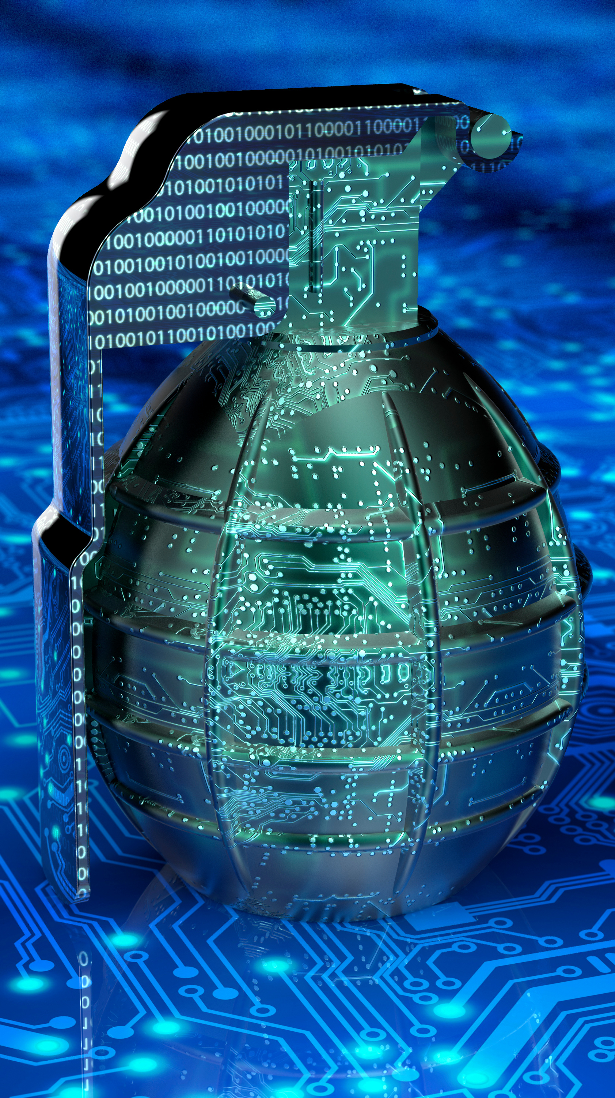

Fighting
Killware
Today
Guillermo Vargas, CEO
Linda Renn, Guest Speaker
April 2022

Slide 2
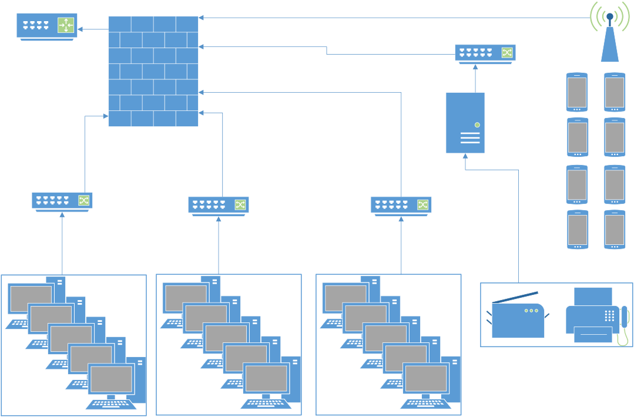
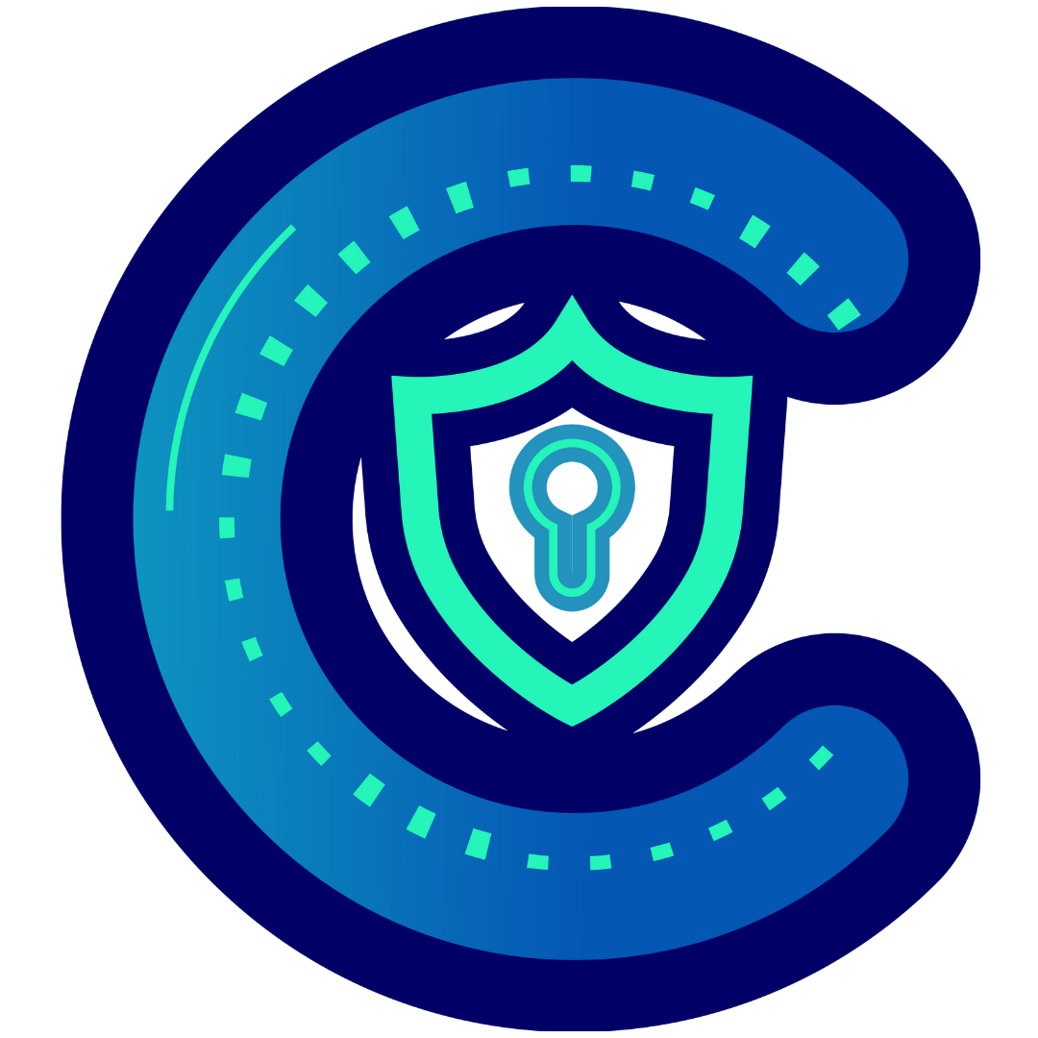
Where we were
Centralized location(s)
Easy management
Remote work was not the norm
Breaches were easily identified and mitigated/eliminated
Network technicality was low (due to centralized networks)
Employees confused security with IT

Slide 3
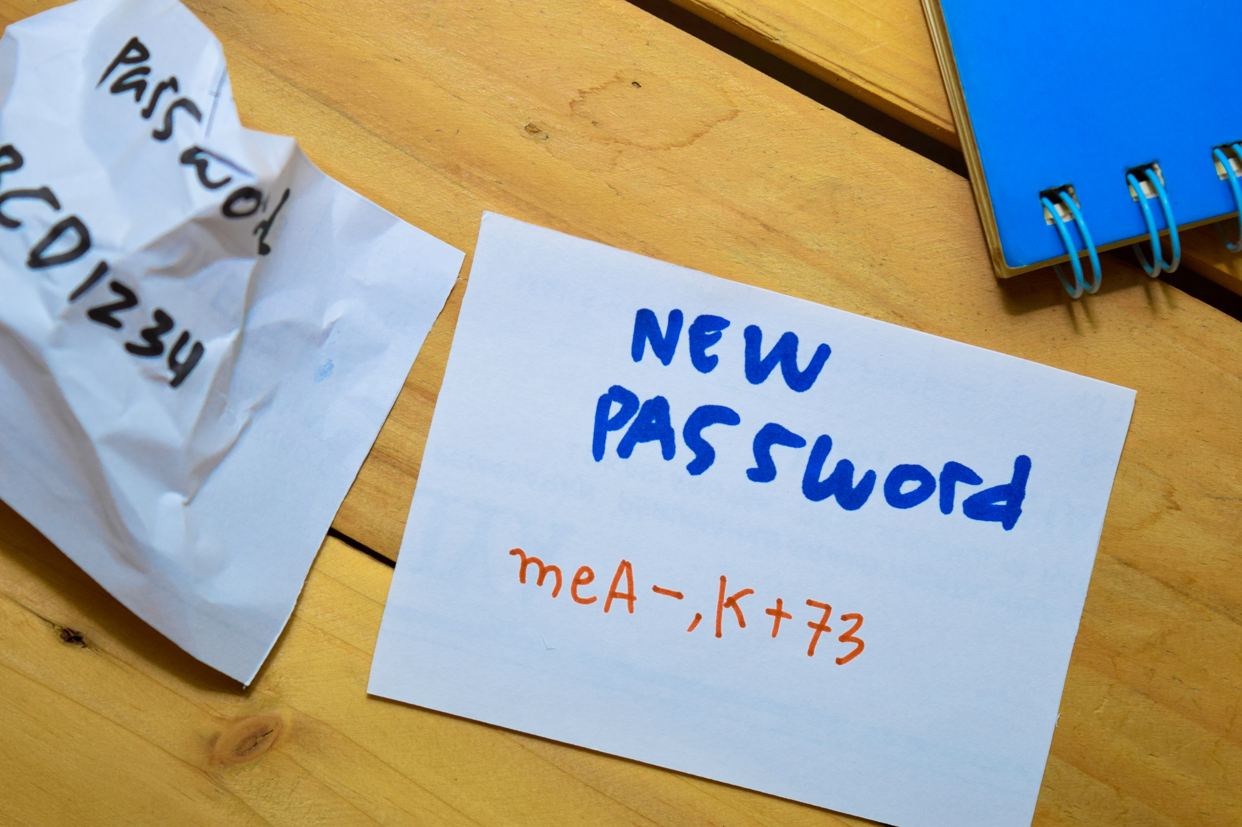
How offices thought they were doing
Employing best security practices
Ready for attacks
Too small to be targeted
Too much money spent to be hacked
No one really hacks networks, so I will be fine.
We are secure enough to not need MFA or strong passwords.

Slide 4


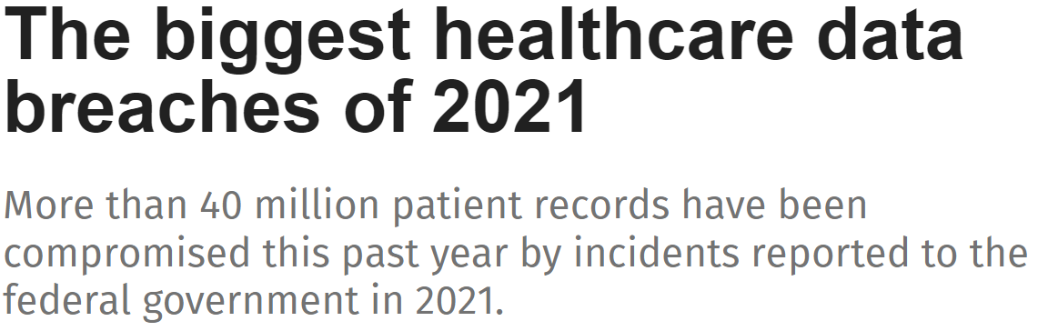
Wakeup Call
All resolved breach reports and/or reports older than 24 months to Oct. 21, 2009. (11 years)
Affected Individuals Reported: 267,254,170
Breaches reported within the last 24 months that are currently under investigation by the Office for Civil Rights.
Affected Individuals Reported: 60,000,819

Slide 5

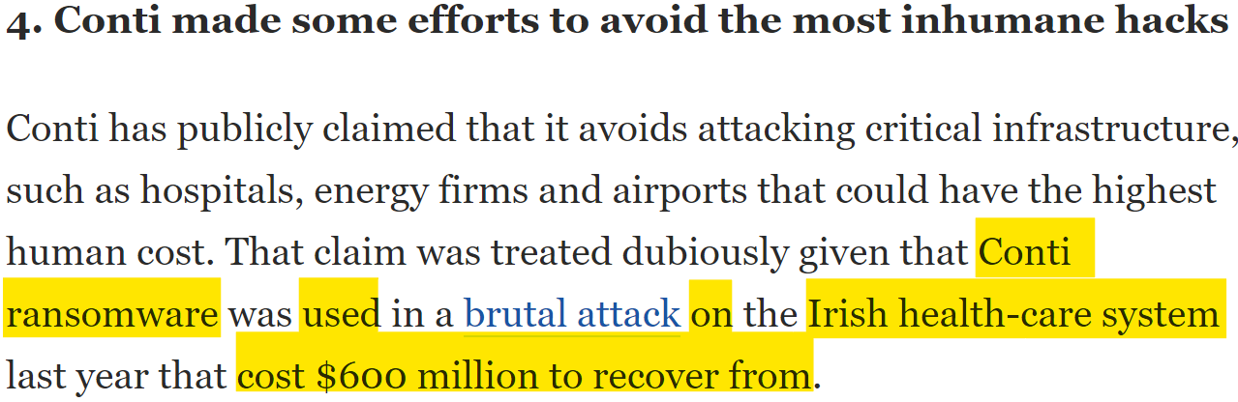
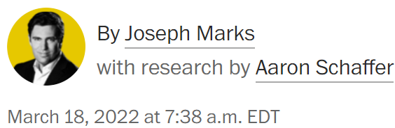
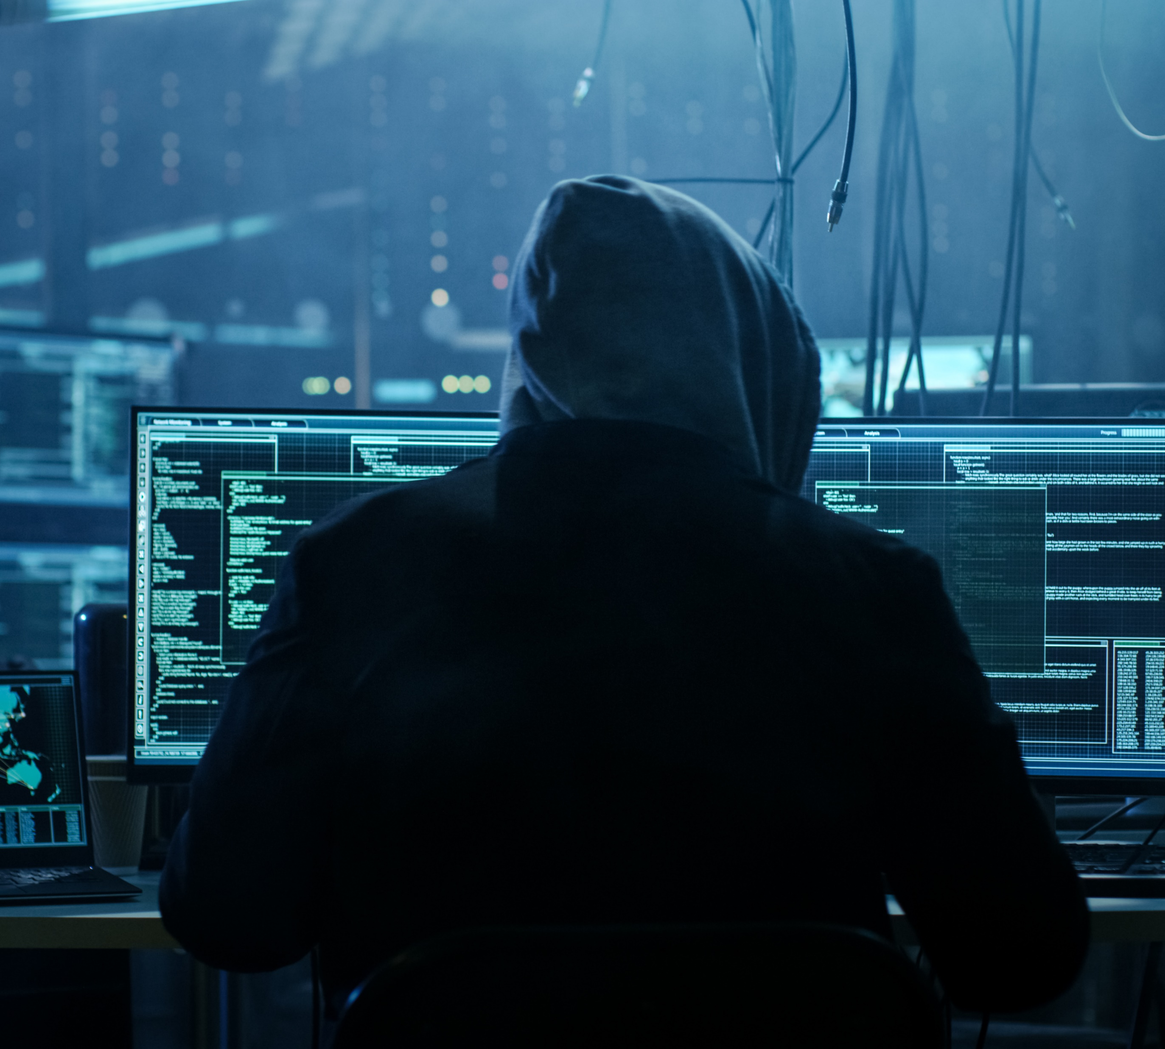
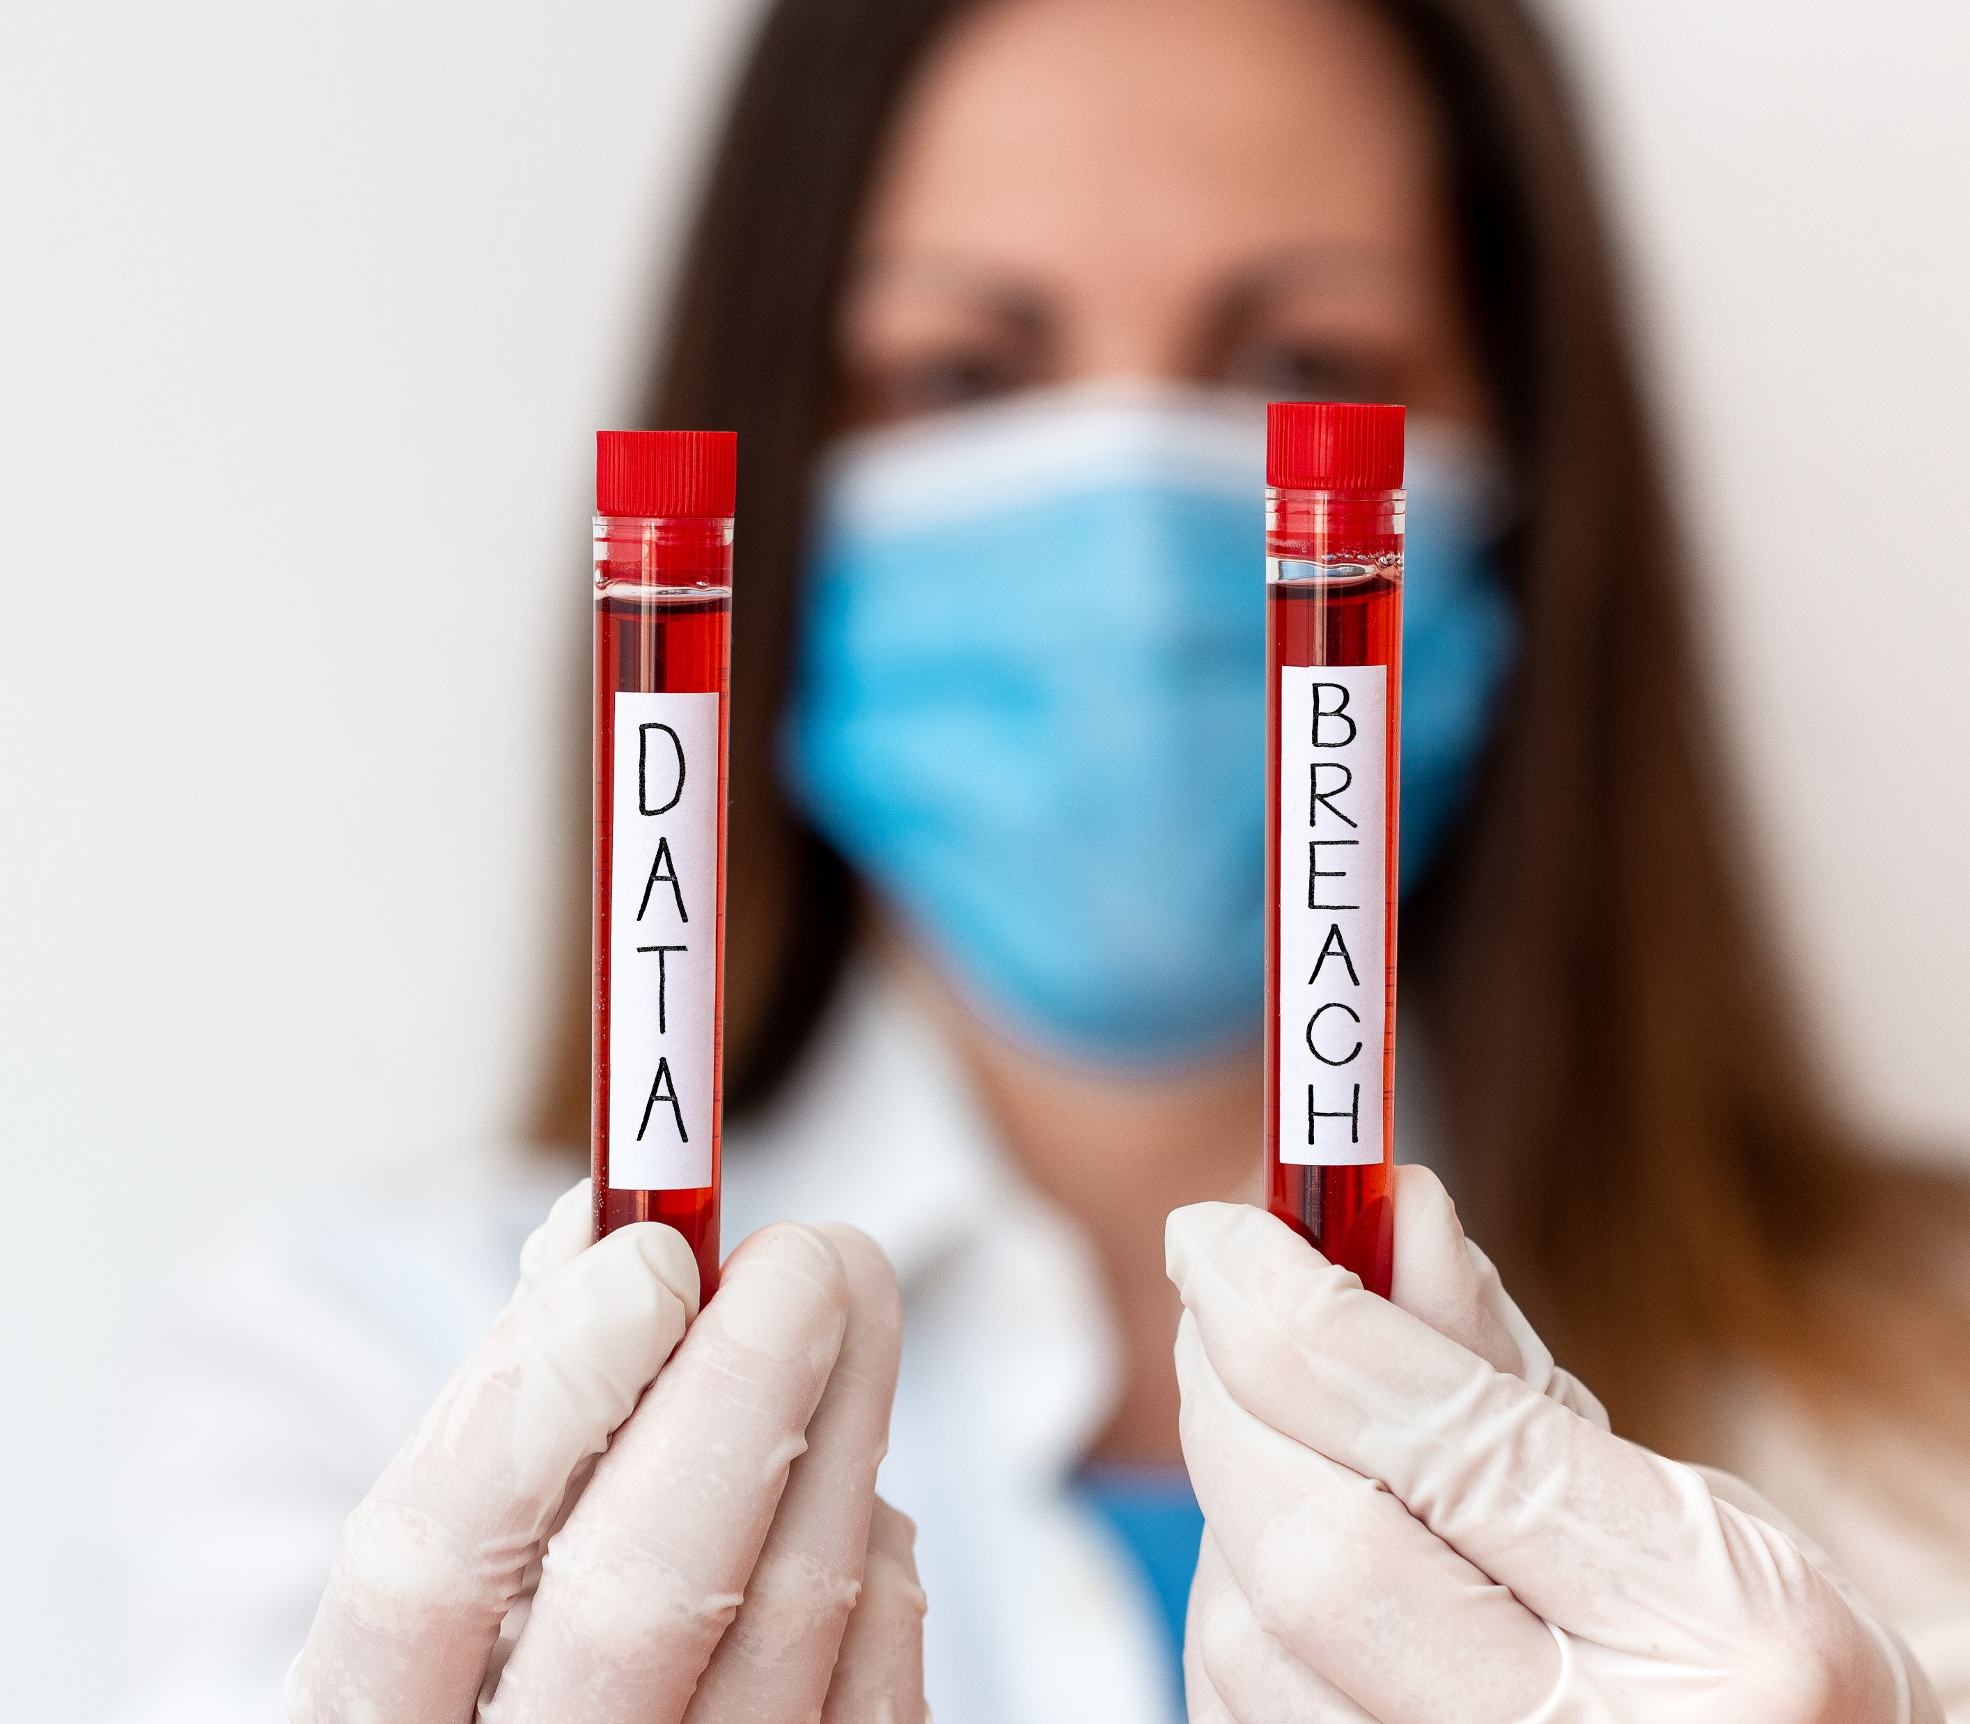
Results
2020
With an estimated 70% of employees working from home part or full-time due to COVID-19, hackers’ opportunities increased.
2021
Cybercrime outgrowing/outgrows health care
Cybercrime is a growing, highly successful and profitable industry. According to Cybersecurity Ventures, cybercrime costs will grow by 15 percent per year to reach US$10.5 trillion by 2025: the third largest economy in the world, after those of the United States and China.
2022 and forward
It's up to health information leaders to improve cyber security within their businesses.
$600 Million

Slide 6
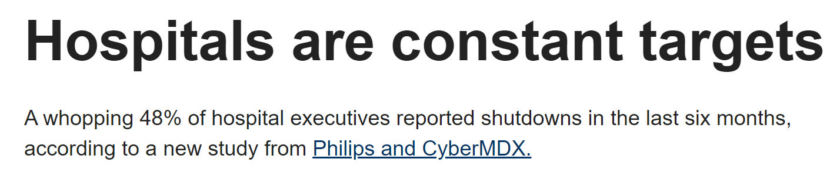

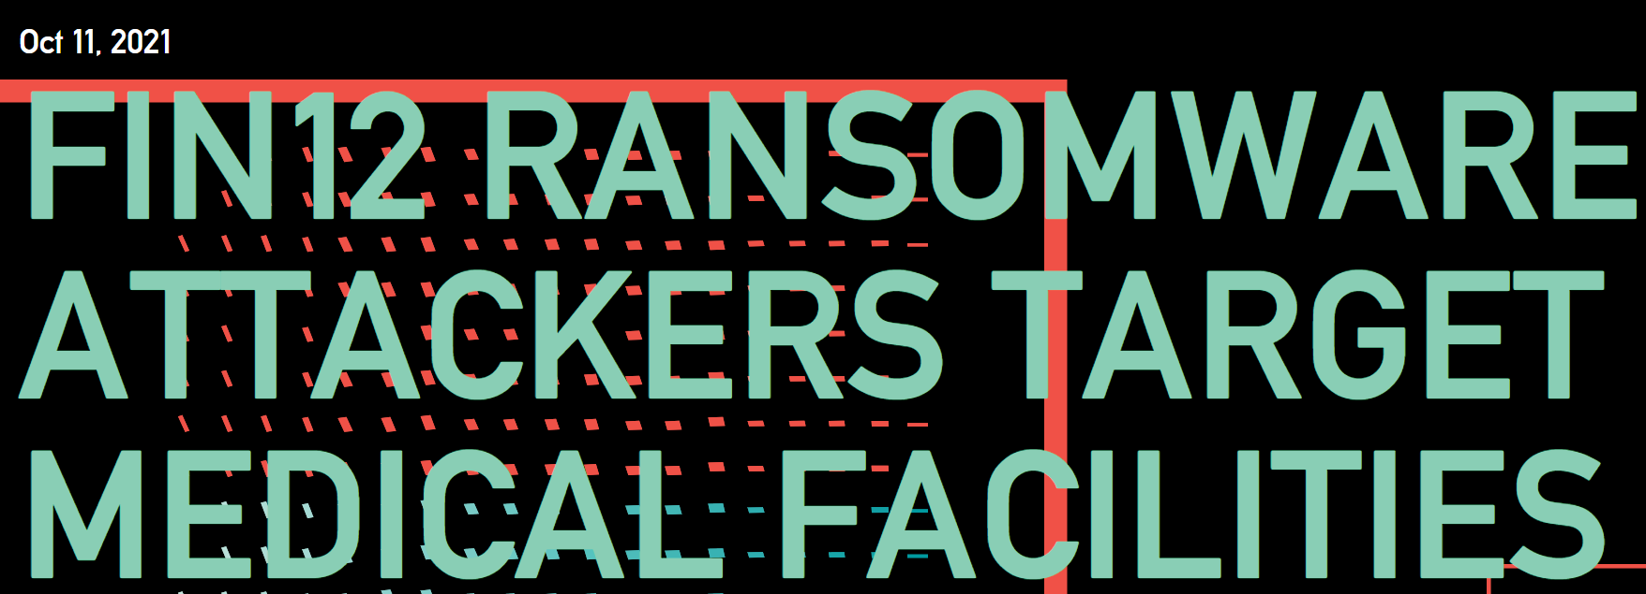

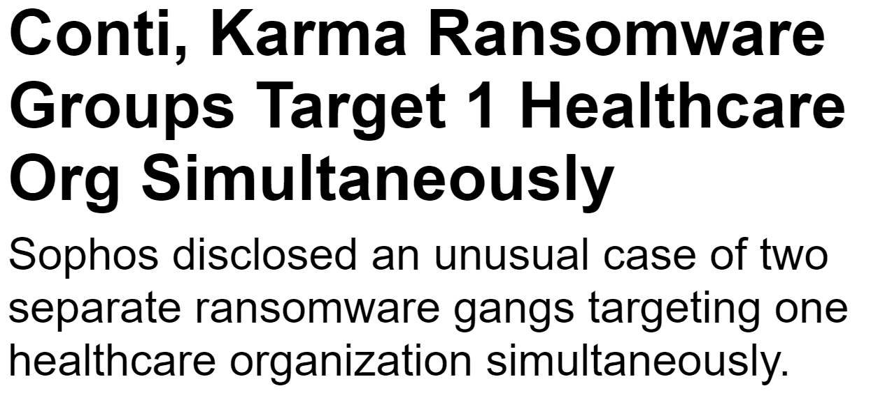


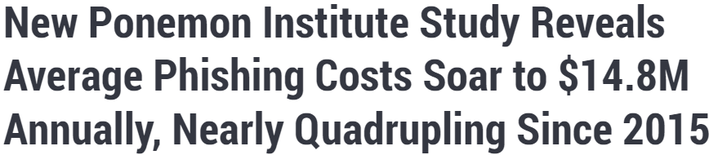
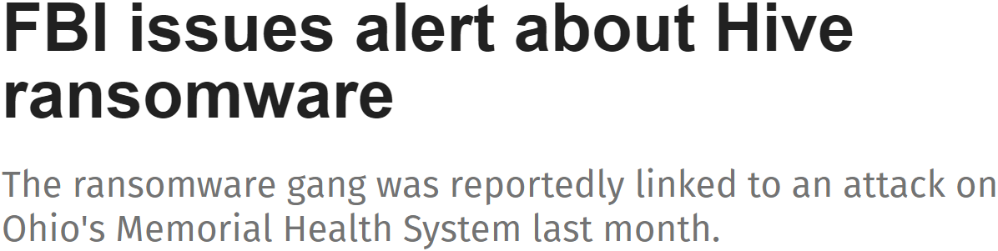


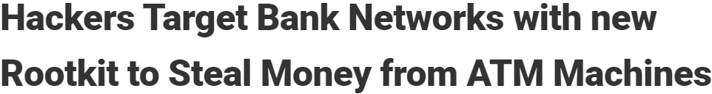
Threat Vectors
Email – spam, phishing, business email compromise (BEC)
Network – ARP tables are inherently not secure, BYODs vulnerabilities/weaknesses, multiple remote networks, unencrypted traffic
Software – vulnerabilities/weaknesses, ransomware as a service (RaaS), malware, backdoors
Hardware – vulnerabilities/weaknesses, backdoors, accessibility
NOT ONLY ENCRYPTING FILES

Slide 7
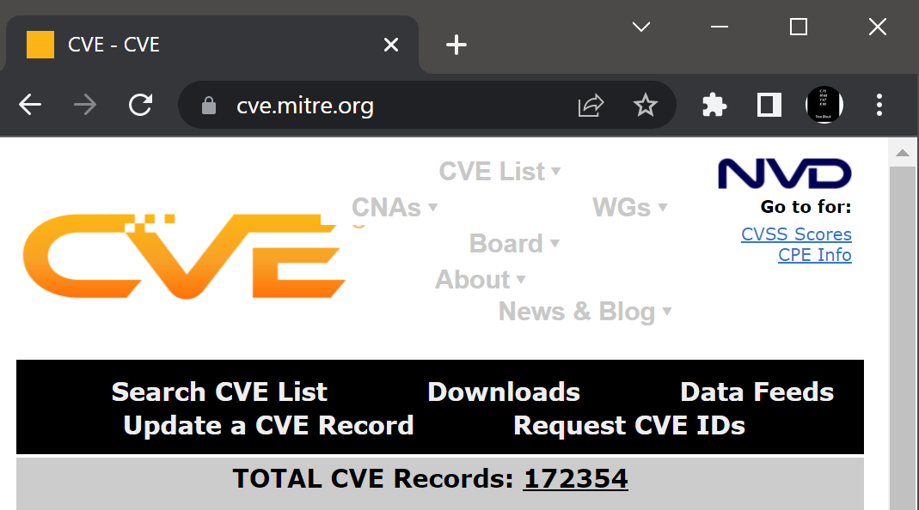

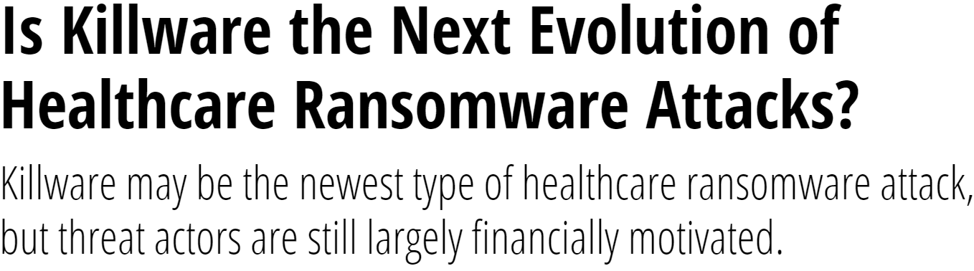


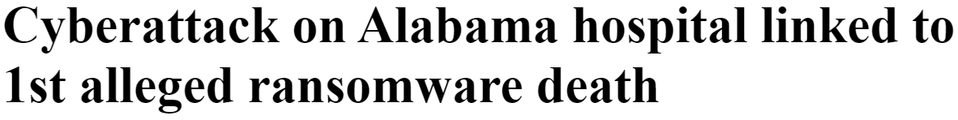
Killware
Most life support systems are dependent on technology.
Doctors cannot make proper life-saving decisions without a patient’s medical record(s)
Anyone accessing the system is a weakness to any information system
Hackers exploit weakness when common vulnerability exploits (CVEs) are available. Currently, more than 170,000 common vulnerabilities have been recorded.
Stopping it now before it becomes infamous is PRIORITY.

Slide 8









Offensive Security
Hunting weakness/vulnerabilities comes first (threat hunting, pen testing, risk assessments, etc.)
Exploiting weaknesses/vulnerabilities
Attacking one’s systems (with experienced personnel and tools)
Proactive security mentality
Treat environments uniquely.

Slide 9






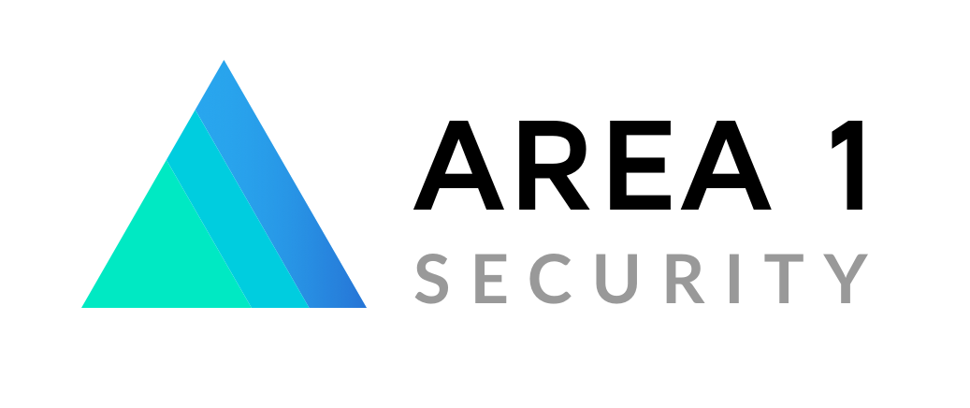
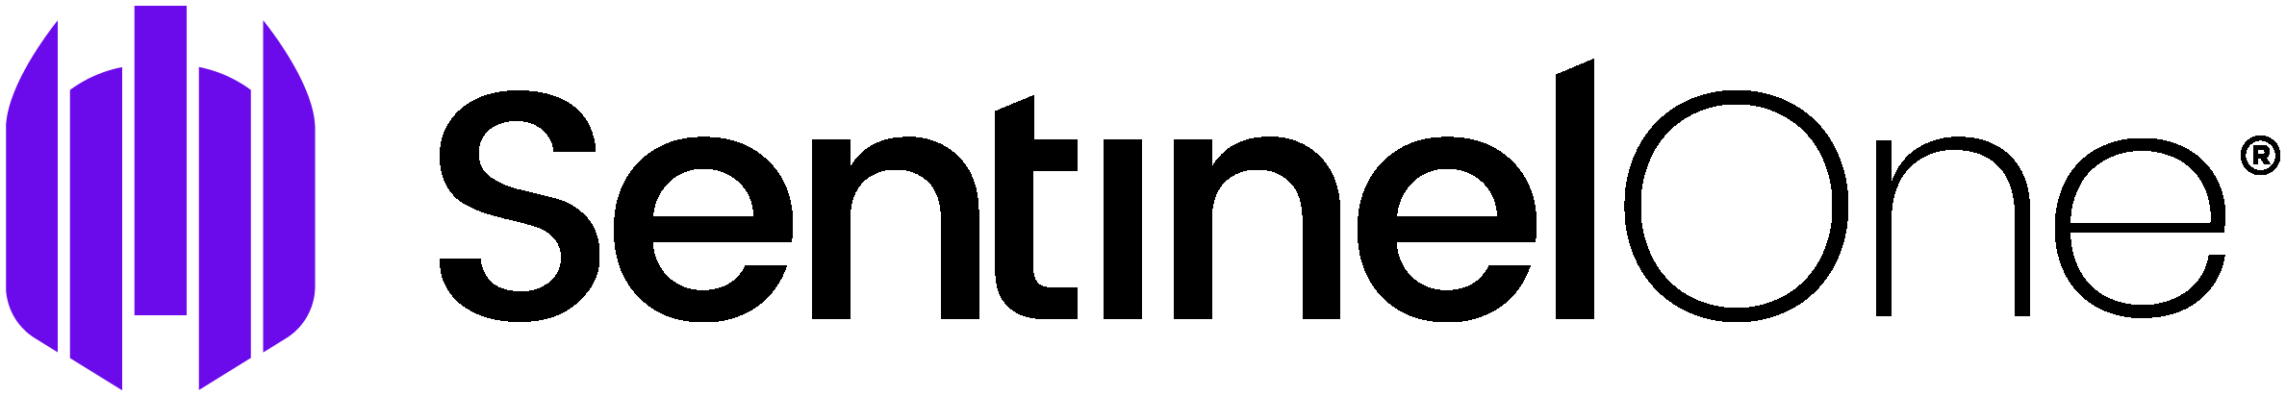
Defensive Security
Continuously protect/harden EVERYTHING (active endpoint detection and response (EDR), intrusion protection system (IPS), etc.)
Access controls (digital and physical)
Policies and procedures (BAA, SLA, Privacy Statement, etc.)
Cyber security training and awareness
Maintaining compliance

Slide 10
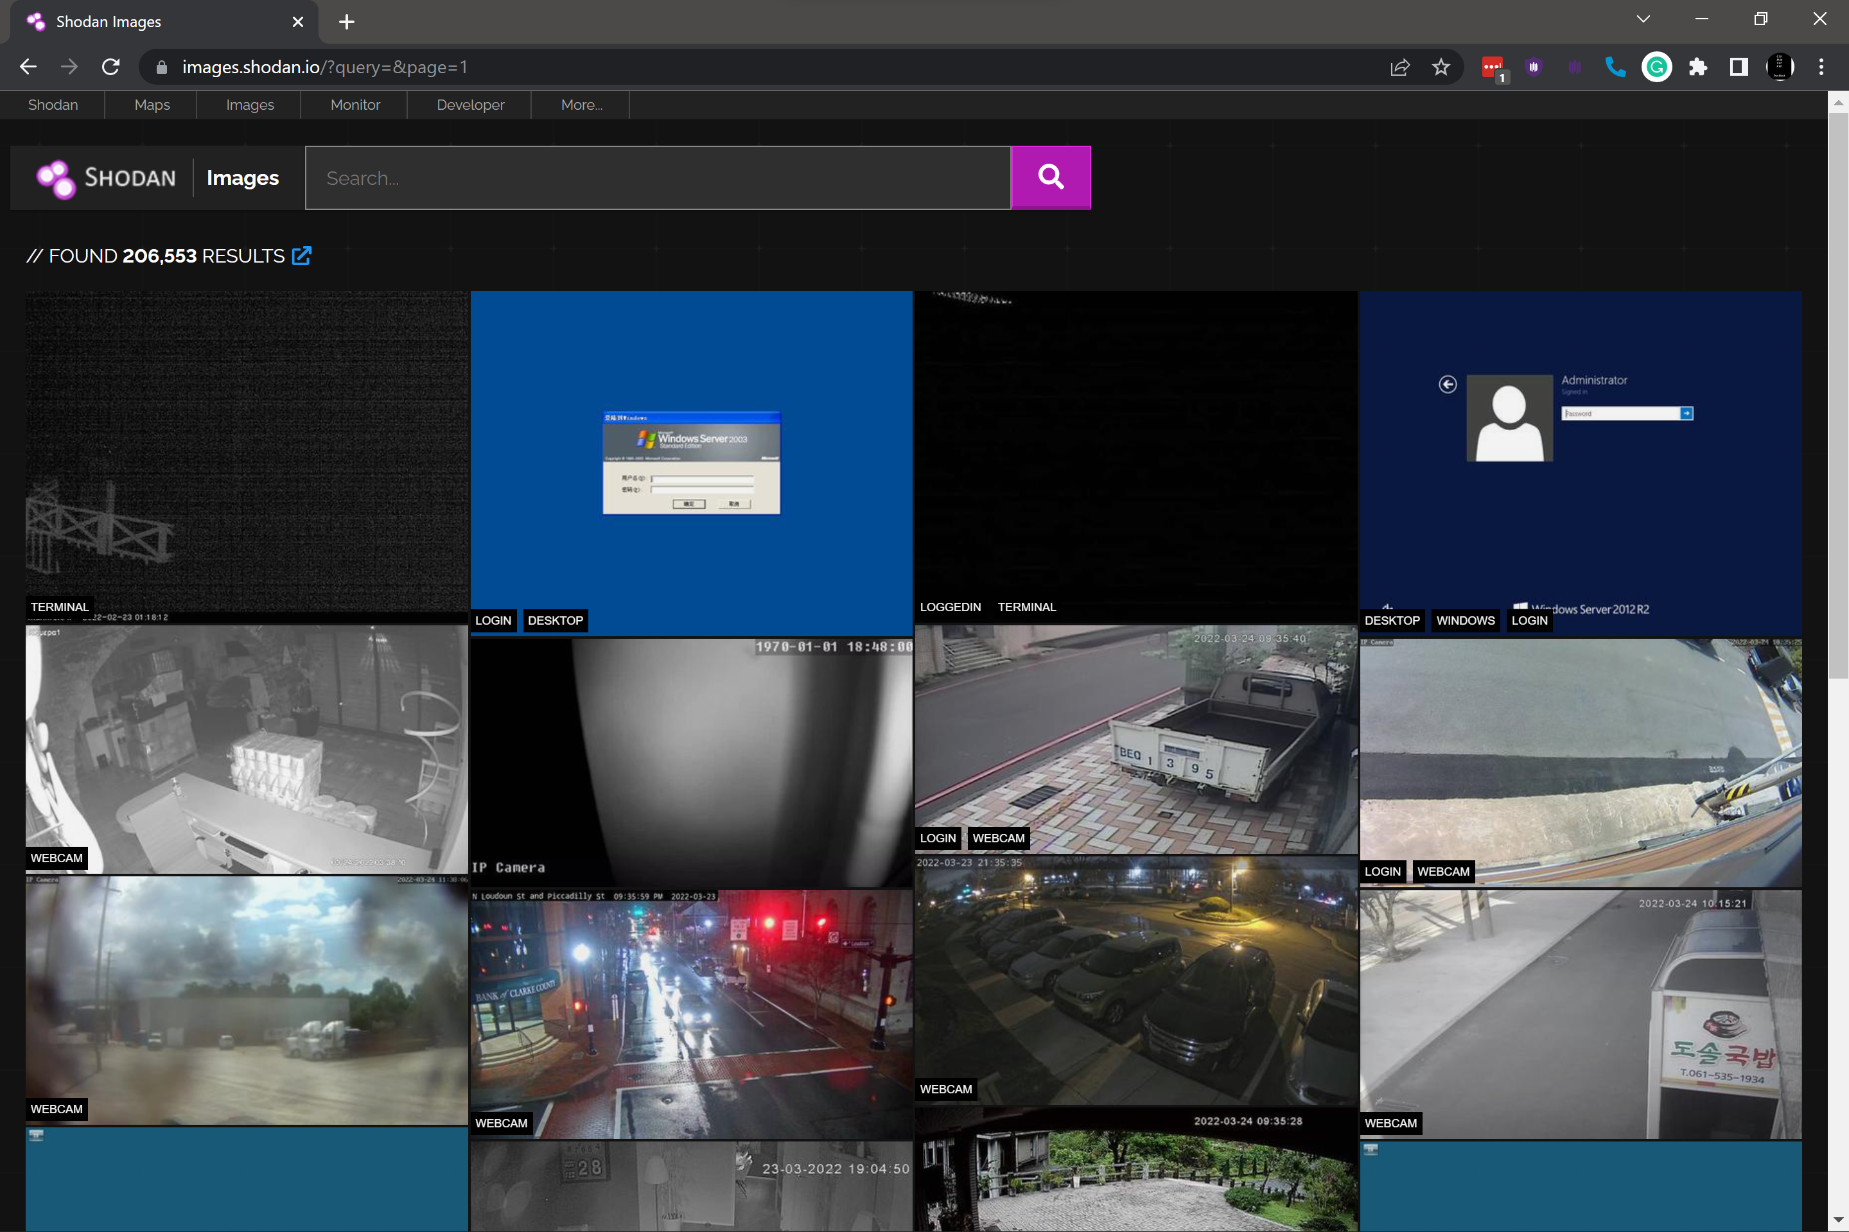
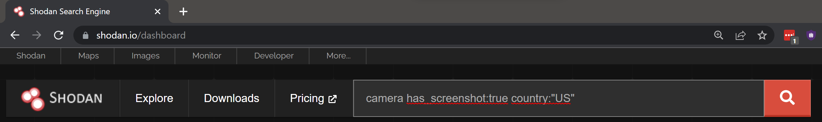
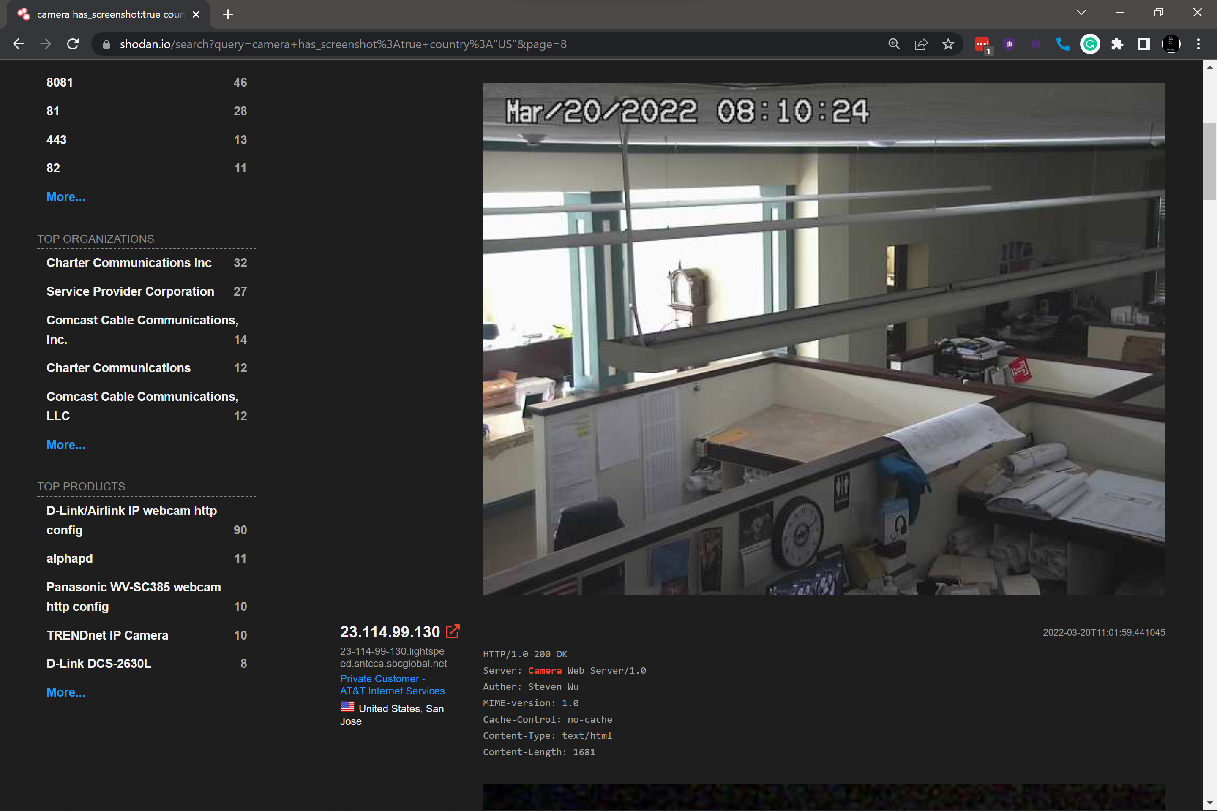
Real-world Vulnerable Networks
camera has_screenshot:true country:"US"

Slide 11
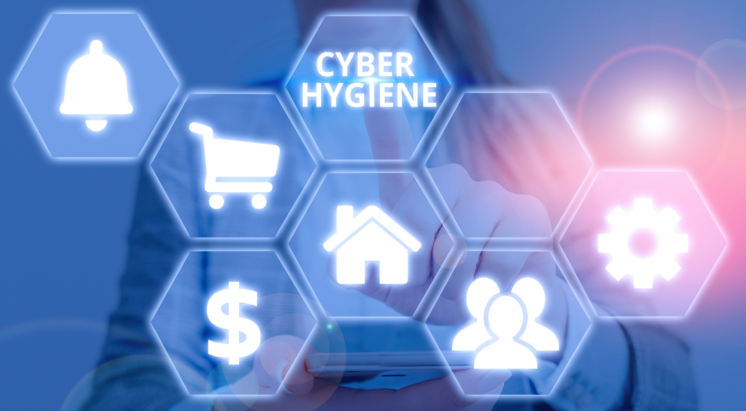

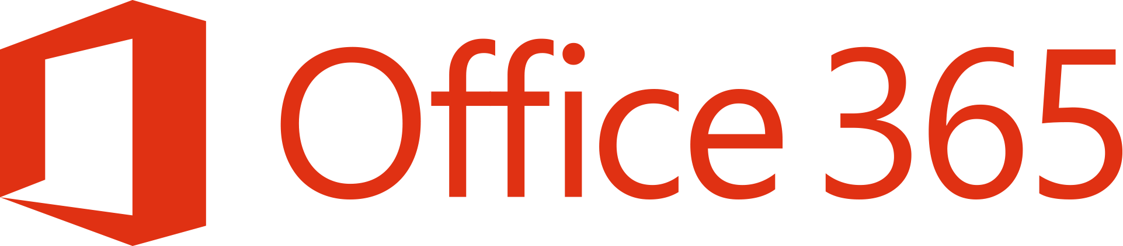








Best Practices

Slide 12

More questions: guillermo@weccode.com

